Slide 1

SHRI BALAJI INSTITUTE OF TECHNOLOGY & MANAGEMENT BETUL (M.P.)
MINOR PROJECT OF LIBRARY MANAGEMENT SYSTEM
Submited By:
Presented by:
Anshika Pawar: 0545CS221006
Shikha Digarse: 0545CS221061
Tapasya Waghmare: 0545CS221066
Parul Salode:0545CS221045

Slide 2
CONTENT
Introduction
Features
Use case diagram
Modules
Advantages of the System

Slide 3
INTRODUCTION
Definition : A Library Management System (LMS) is a software application that helps manage and automate library operations.
Purpose : The primary purpose of an LMS is to provide a centralized platform for managing library collections, patrons, and services.
Problem Statement
Inefficiencies in manual library systems
Difficulty in tracking books and members
Time-consuming processes for book issuance and return

Slide 4
Features Key Features of a Library Management System
Book Catalog:
Add, edit, and delete books. * Categorize books by genre, author, or subject. * Search for books by title, author, or keyword.
Member Management:
Add, edit, and delete members. * Track member information like name, address, and contact details.
Technology Considerations:
Database:
Use a relational database like MySQL or PostgreSQL to store book, member, and transaction data.
Programming Language:
Choose a language like Python, Java, or C# for development.
Web Framework:
Utilize frameworks like Django, Flask, or Spring Boot to build web-based systems.

Slide 5
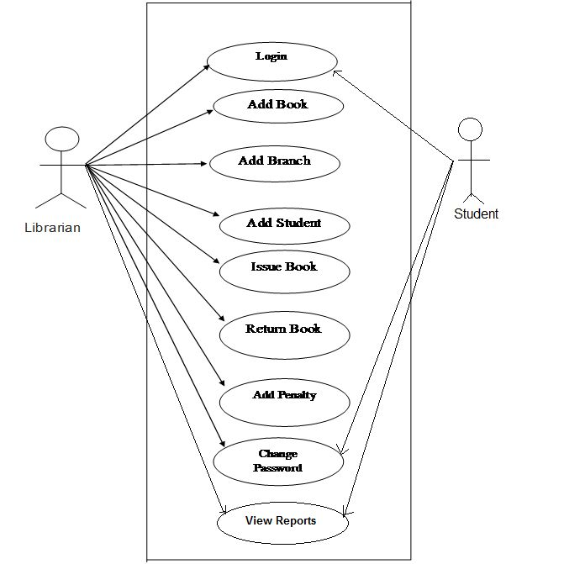
USE CASE DIAGRAM :- library management system

Slide 6
Advantages of the System
Improved Efficiency: Faster book search, issue, and return processes
Accurate Record Keeping: Reliable tracking of books and members
Enhanced User Experience: User-friendly interface and streamlined operations
Reduced Human Error: Minimized errors in manual data entry

Slide 7
MODULES
Add New Books
Add Branch
Add Student
Issue Book
Return Book
Change Password

